Slide 1


Predicting the performance of an employees
Working from remote locations

Slide 2

PROJECT LEADERSHIP
Sharat Manikonda
Director at Innodatatics and Sponsor
linkedin.com/in/sharat-chandra

Slide 3

CONTENTS
Project overview and Scope
CRISP-ML(Q) Methodology
Project Goals
Technical Stacks
Project Architecture
Data Collection
Data Understanding
Data Preprocessing
Exploratory Data Analysis
Model Selection and Building
Model Tuning and Training
Model Evaluation
Output
Model Deployment
Pros and Cons
Challenges and Future Scope
Conclusion

Slide 4

PROJECT OVERVIEW AND SCOPE
This project aim is to help organizations by evaluating the performance of their employees when they are working from a remote location.
Every organization is facing difficulties to motivate their employees so that they can work efficiently in a new environment.
Reduce the insecurity of employees towards their jobs and increase job satisfaction.
By evaluating employees performance, we can suggest them to take a appropriate action and make changes in their strategies for individual and organization growth.
Scope of this project is to motivate, enhance employees skills set both psychological and technical so that they can increase their productivity and perform effectively towards organization goals.

Slide 5
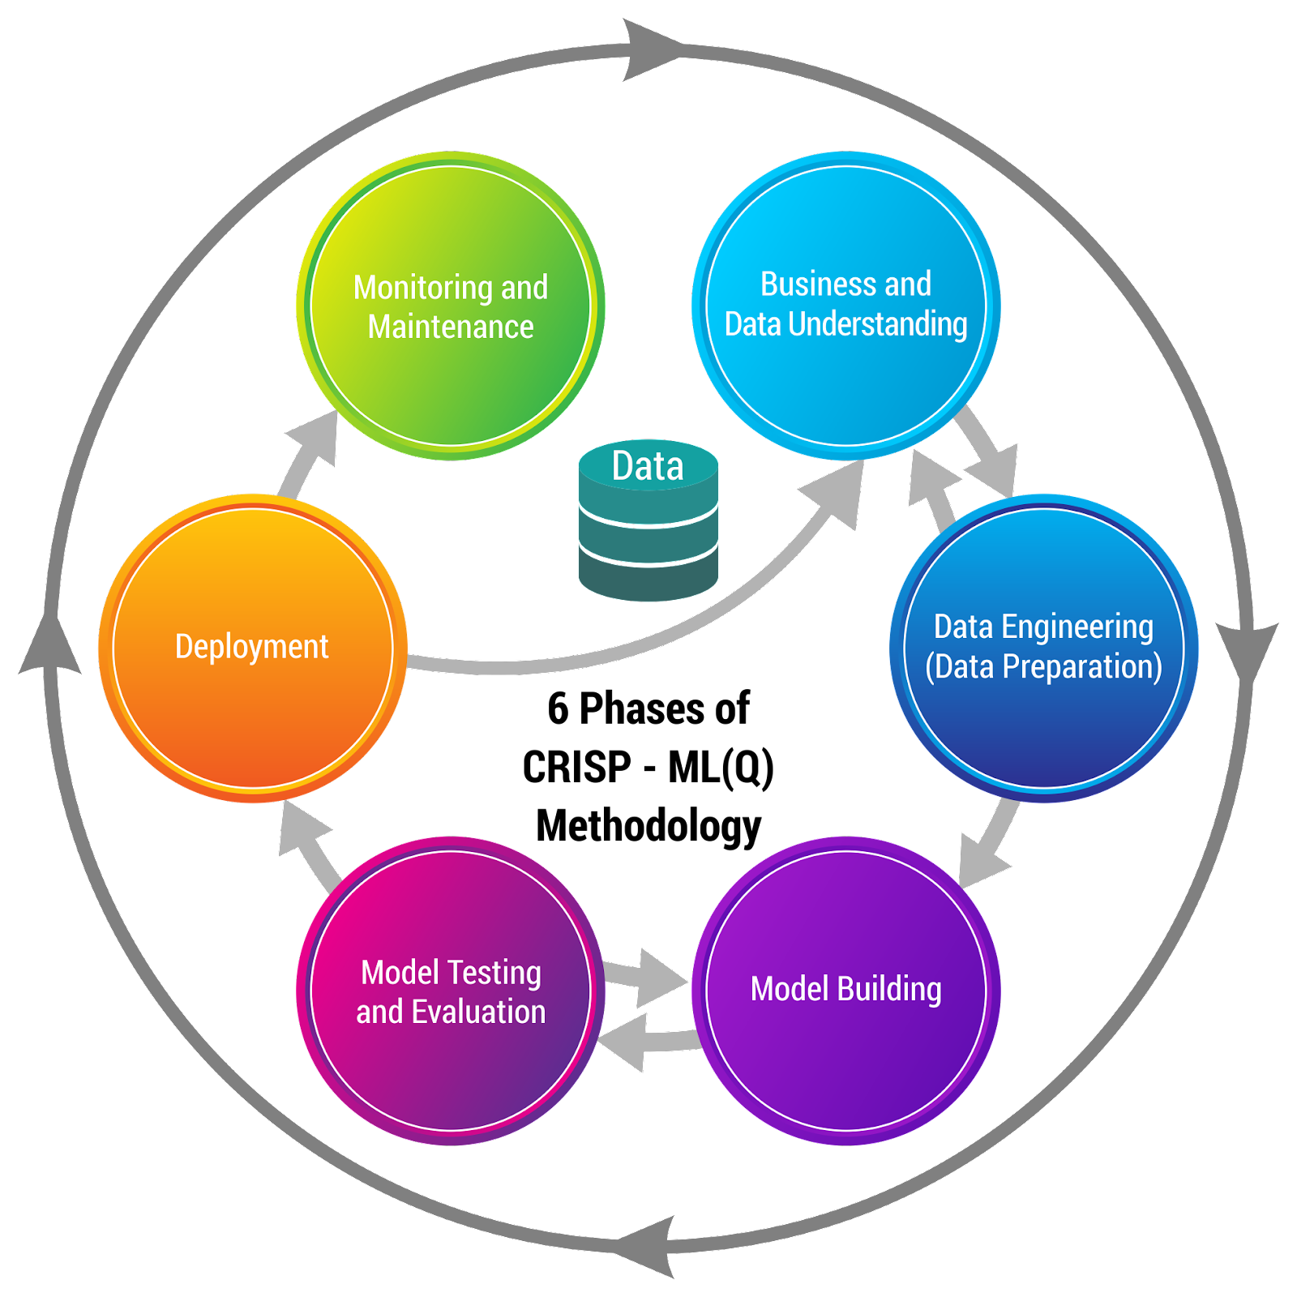
CRISP-ML(Q) METHODOLOGY

Slide 6

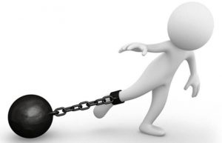

PROJECT GOALS
OBJECTIVE
Maximize: Employees productivity and improve their skills
set towards the organization goals.
CONSTRAINTS
Monitor and Tracking activities of employees when they are working from home is difficult.
It is not feasible to use similar parameters for evaluating employees performance working from home and office.

Slide 7



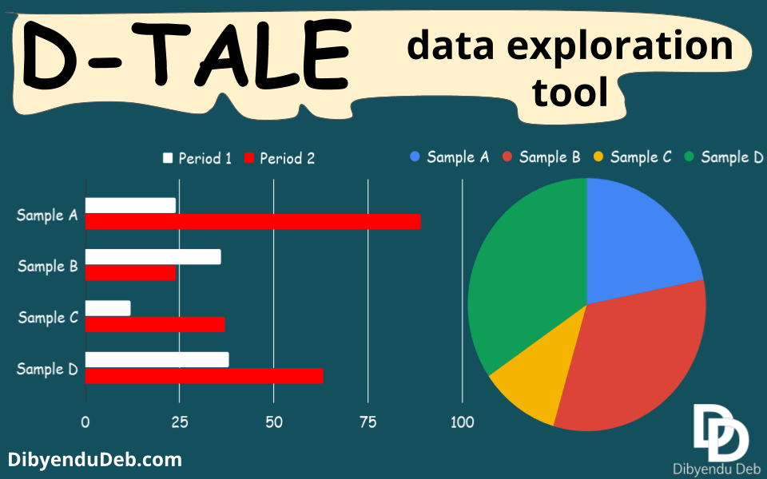




TECHNICAL STACKS
Database
IDE
Auto-EDA tool
Language
7

Slide 8
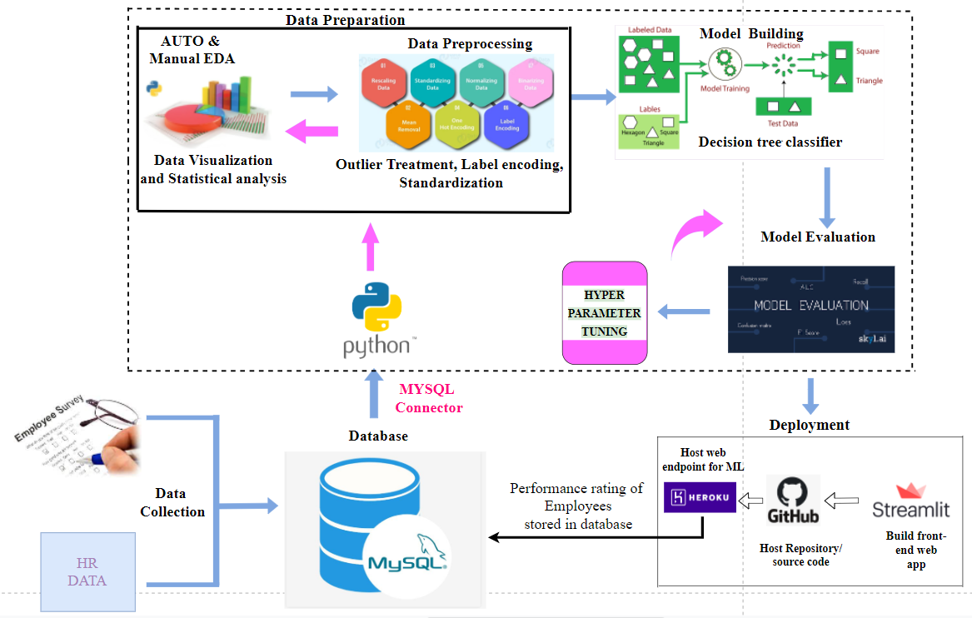
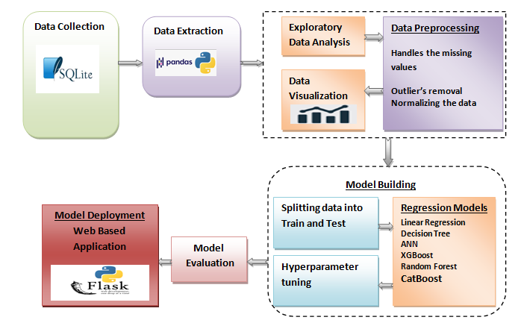

PROJECT ARCHITECTURE

Slide 9
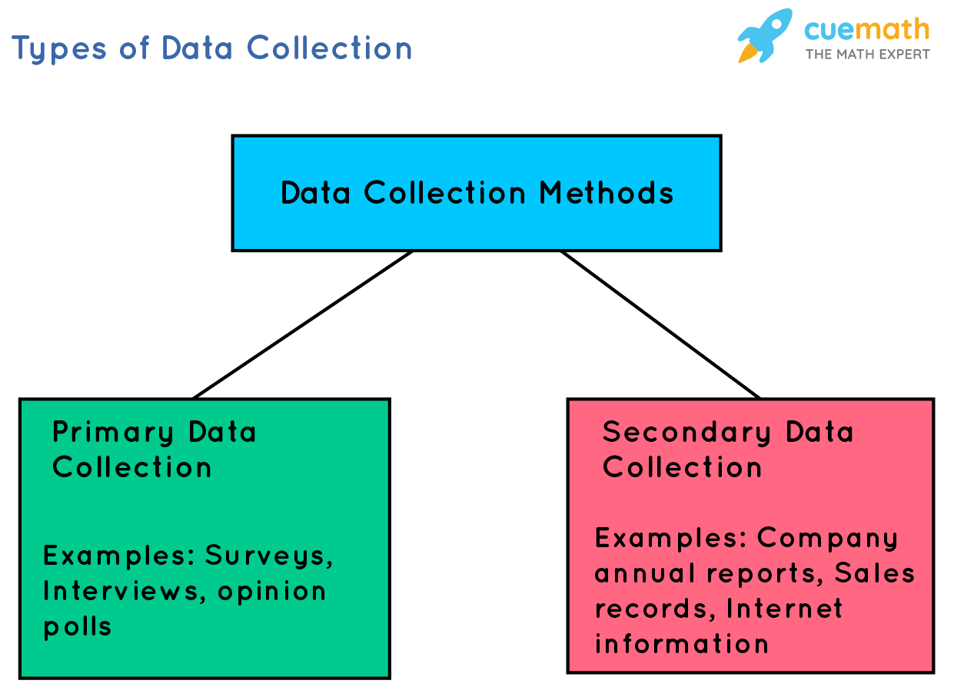
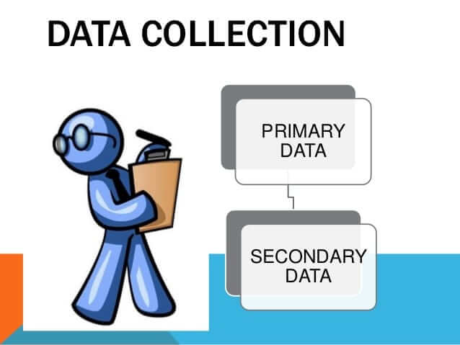

DATA COLLECTION
Data gathered manually as most of the metrics that we have chosen to create a dataset are not available in internet.
Primary source: Parameters are decided by studying various research papers on which basis we have to evaluate employee performance and conducted a survey to gather information by creating google forms.
Secondary Source: Data is gathered from HR team of IT industry as they have historical data related to work from home.
All the Employees information are merged together and stored in MS SQL SERVER database.
Data is extracted from MS SQL SERVER database to python using MS SQL Connector library providing server, database and table name.

Slide 10
DATA UNDERSTANDING:DATA DICTIONARY
Data is pulled from the MS SQL SERVER database. It has 5100 records and 28 fields which includes
7 numerical and 21 categorical features.
Target variable: Performance Rating. It is a Categorical feature which has good, average, and poor as a class.
FEATURES | DESCRIPTION
1. Employee ID | It is a unique Id given to employee in any organization.
2. Age | Age of employee -Range between 21 to 50
3. Gender | Two category -male and female
4. Marital Status | Three category -divorced, married and single
5. Education | Level of education - bachelors, masters, PhD, vocational
6. Environment Satisfaction | It is a work environment of a company which is a collection of situational factors that forms a corporate atmosphere. - low, medium, high, very high
7. Job Involvement | Job Involvement explains the role and responsibility of an employee towards the organization. - low, medium, high, very high

Slide 11
DATA DICTIONARY
FEATURES | DESCRIPTION
8. Job level | Job level is categories with different titles and salary ranges within a workplace. - 1 , 2, 3, 4, 5
9. Job Satisfaction | It explain how satisfied employees are with elements like their jobs, experience and organization they work for. - low , medium , high , very high
10. Annual income | Annual income is the total value of income earned during a fiscal year. - Range between 1 to 40
11. Relationship Satisfaction | It is subjective (EOR) for both employees and employers and their expectations of one another in the workplace. - low, medium, high, very high
12. Working hours per day | Number of hours an employee work per day. - equal to 9, greater than 9, less than nine
13. Experience | Work experience an employee holds in years. - between 0 to 33
14. Training time | Number of weeks an employee undergoes a training period. - 1 , 2 , 3 , 4 , 5 , 6

Slide 12
DATA DICTIONARY
FEATURES | DESCRIPTION
15. Work Life Balance | It is a state of equilibrium where the person equally prioritized professional life and personal life. - bad, better, good, best
16. Behavioural Competence | It refers to any behaviour attributes and personality traits. - Poor, inadequate, satisfactory, very good, excellent
17. On time delivery | It is a key performance indicator metric to evaluate performance of employees. - poor, satisfactory, good, excellent
18. Ticket Solving Management | It is a process to tracking, managing and resolving user requests and incidents. - poor, satisfactory, good, excellent
19. Project Completion | It is a total no of project completion by an employees within a given period of time. Between 1 to 14
20. Working From Home | Whether employee is working from home or office. - yes, no
21. Psycho-social indicators | Factors in the management that increase the risk of work related stress. - poor, inadequate, very good, excellent

Slide 13
DATA DICTIONARY
FEATURES | DESCRIPTION
22. Over time | Overtime refers to number of hours worked by an employee that exceed their normally scheduled working hours. - yes, no
23. Attendance | Workplace attendance is the hours and days that employees show up for work. - good, poor
24. Percent Salary Hike | It refers to percentage of increment in an employee salary on the basis of his current annual income in respect to his experience and job level. - Range between 1to16
25. Net Connectivity | Do employee has any issues with net connectivity while working from remote location. - poor, good
26. Department | Department in which employee works. - finance, IT, R&D, sales, HRM
27. Position | It is a job title that describe employee duties and responsibility. - scientist, budget Analyst, team leader, developer, HR, executive
28. Performance rating | It refers to the effectiveness , quality efficiency of employees work. - good, average, poor

Slide 14
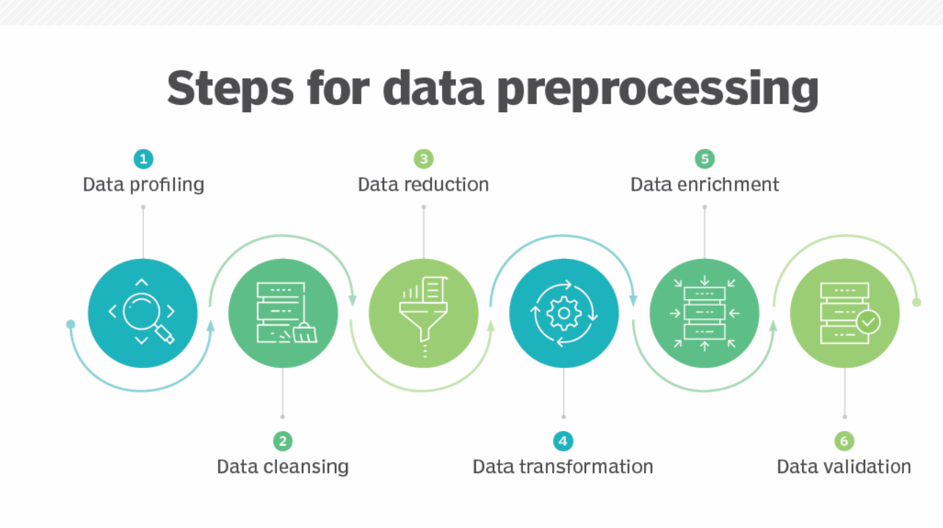
DATA PRE-PROCESSING

Slide 15
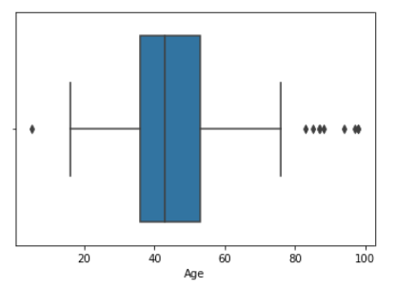
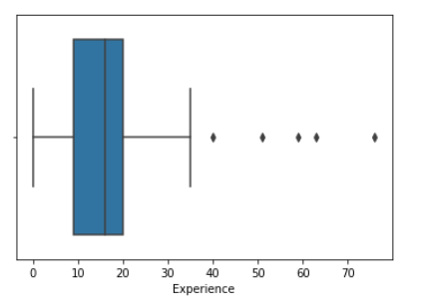
OUTLIER DETECTION
To find the hidden patterns and distribution of data different visualizations were plotted using Matplotlib and Seaborn libraries in python.
Checking outliers – Boxplot for Age
Boxplot for Experience
INSIGHTS: AGE
It is right skewed data as right tail of whisker is slightly bigger than left tail and median is also closer to Q1.
It has outliers
INSIGHTS: EXPERIENCE
It is left skewed data as median is closer to Q3.
It also has outliers

Slide 16
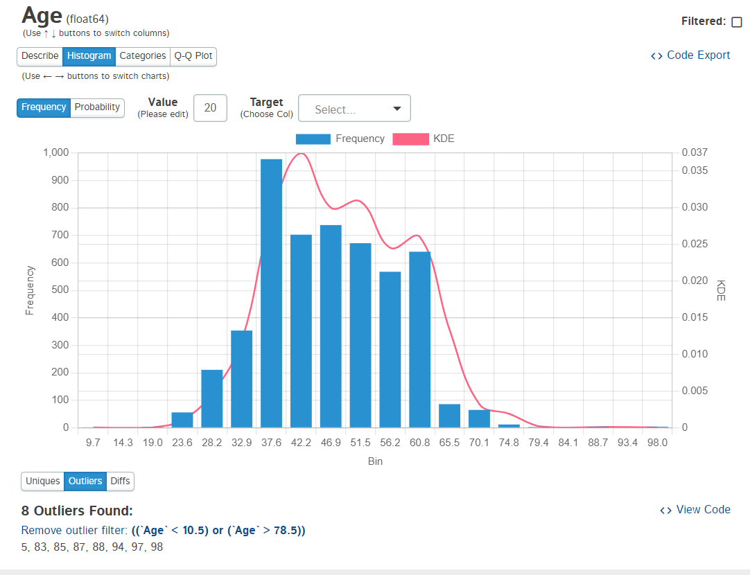
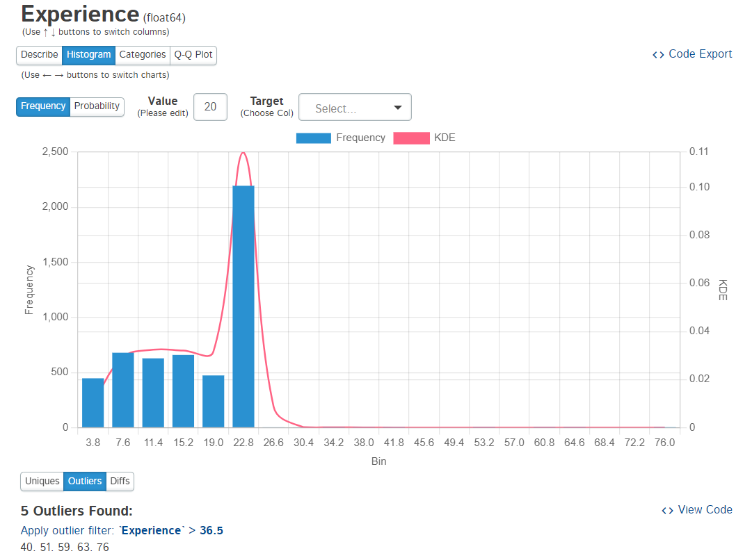
DISTRIBUTION OF DATA
We can see that D-tale and autoEDA tool also shows the outliers present in the age and experience feature.
The data distribution of Age attribute skewed towards slightly right and for experience attribute skewed towards left.

Slide 17
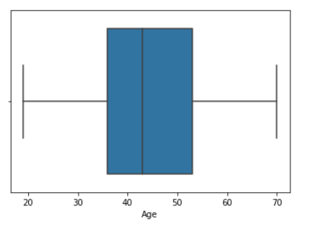
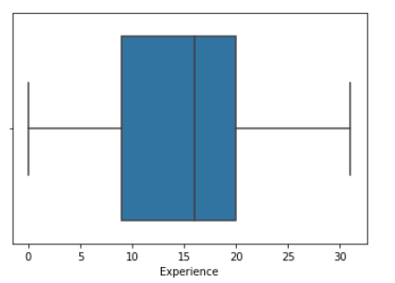
DATA PREPARATION
Outliers Treatment: Winsorization technique, IQR method is used which describes quantile values and Inter quartile range.
Lower limit of acceptable range = Q1 – 1.5* (Q3-Q1), Upper limit of acceptable range = Q3 + 1.5* (Q3-Q1)
Label Encoding: Categorical features are converted into numerical features using a label encoder.
Standardization: To make data on same scale Standard Scaler function is used.
After preparing the data we studied the relationship between different attributes by using Power BI tool.
Box plot Age after treating outlier
Box plot Experience after treating outlier

Slide 18
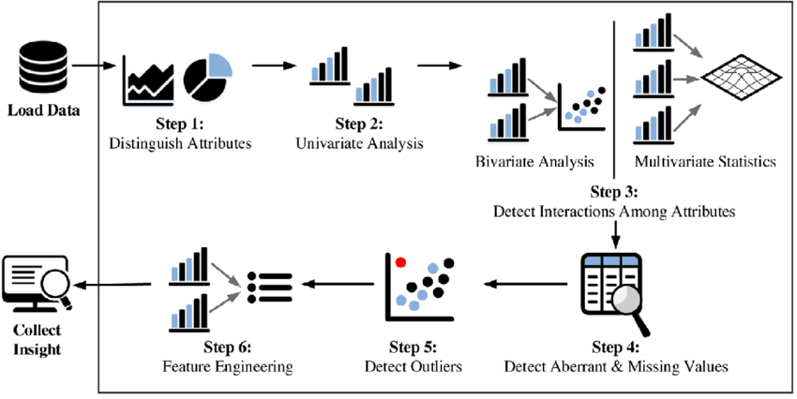
EXPLORATORY DATA ANALYSIS
EDA is a technique to visualize and capture patterns, trends, and hidden insights from the data.
For automated EDA, D-Tale tool is used.

Slide 19
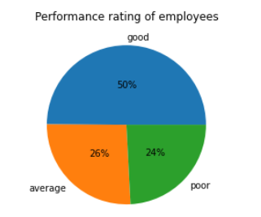
VISUALIZATION BY AUTOMATED EDA
Automated EDA was performed and dataset was analyzed to describe summary of statistics using first-moment business decision – mean, median and mode.
Measures of dispersion – variance and standard deviation.
Third and fourth moment business decision – skewness and kurtosis
Checking scale of data
INSIGHTS:
The target variable, performance rating has imbalanced data.
Good class has 50% of data
Average class has 25% of data
Poor class has 24% of data

Slide 20
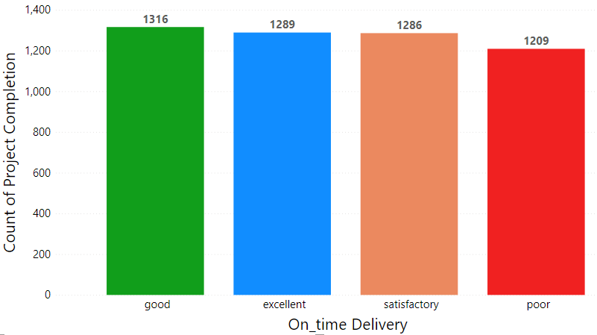
Count of Project Completion by On time delivery
Observation:
Positive correlation is seen between On time delivery and count of project completion.
Employees with good on time delivery are also having higher number of project completion (1316).

Slide 21
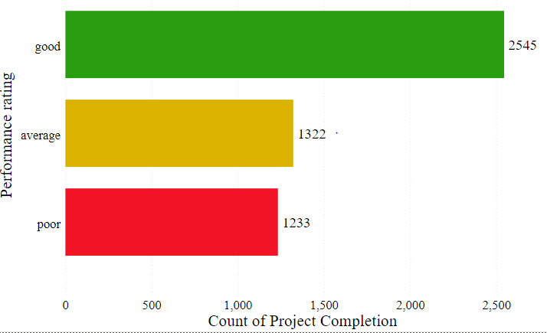
Performance Rating by count of project completion
Employees who completed maximum number of projects have good performance(2545).
Positive correlation between performance rating and project completion.

Slide 22
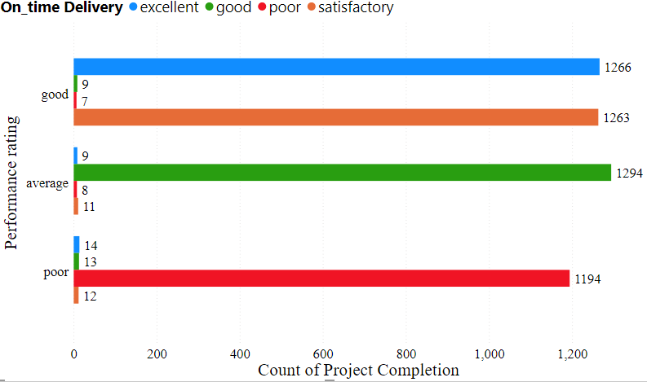
Project completion as per Ratings and On time delivery
Number of project completion
On time delivery | Excellent | Good | Satisfactory | Poor
Ratings
GOOD | 1266 | 9 | 1263 | 7
Average | 9 | 1294 | 11 | 8
Poor | 14 | 13 | 1194 | 12

Slide 23
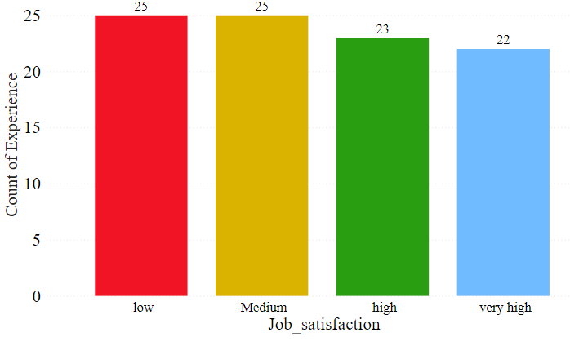
Job satisfaction vs. Experience
Observation:
Employees with more (25yrs) experience have low and medium job satisfaction level.

Slide 24
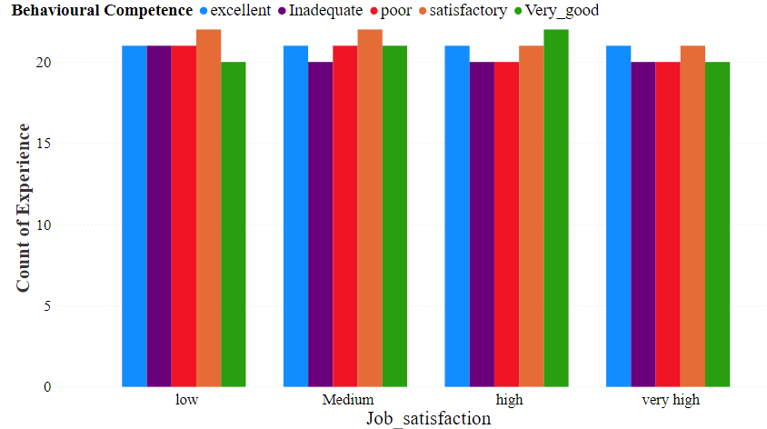
Behavioural Competence by Job Satisfaction
Observation:
Employees having low job satisfaction affects negatively to behavioural competence.

Slide 25
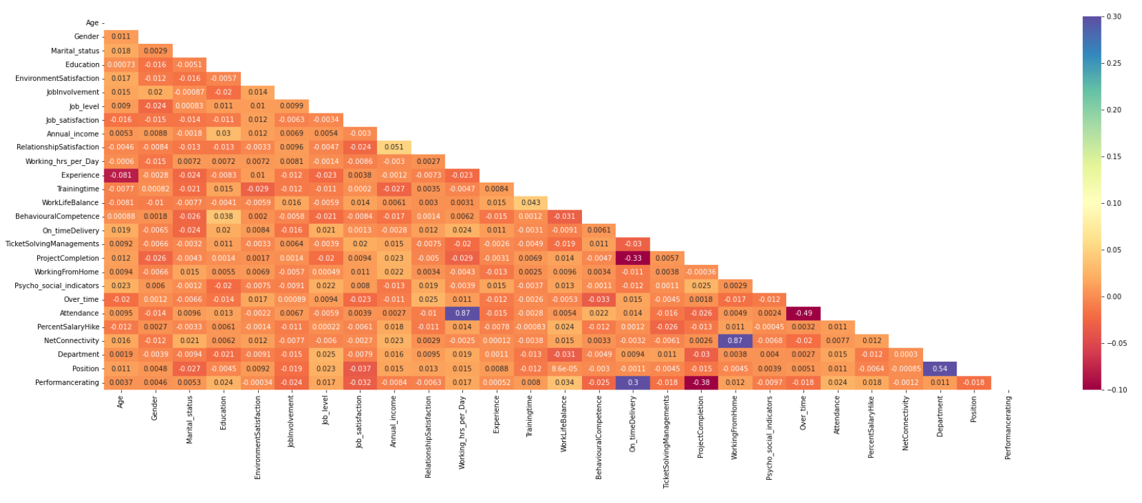
Correlation Heat Map
Observation:
Strong positive correlation is observed between features.
Department and Position – 54%
Working hours per day and Attendance – 87%
On time delivery and performance rating – 30%
Working from home and Net connectivity – 87%
Strong negative correlation is observed between features.
Experience and age – 81%
Project completion and On time delivery – 33%
Performance rating and Project completion – 38%
Overtime and Attendance – 49%

Slide 26
MODEL BUILDING
A machine learning model discovers the patterns in a training dataset.
Building a model in machine learning is creating a mathematical representation by generalizing and learning from training data.
Machine learning models is applied to new data to make predictions and obtain results.
Different algorithm are used on the basis of target variable.
In our dataset, the data type of target variable is categorical.
Supervised and Unsupervised classification algorithms are
used to build the model.

Slide 27
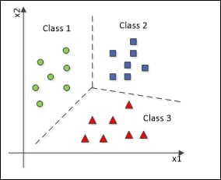
CLASSIFICATION ALGORITHMS
Classification algorithm is used to build a model where output feature is categorical in nature.
Draw some conclusions from the input values given for training.
It will predict the class labels for the new data.
Split the data into train and test in 80:20 ratio and initialize the classifier
to be used.
Train the classifier: All classifiers in scikit-learn uses a fit(x, y) method to
fit the model(training) for the given train data x and train label y.
Predict the target: Given an observation x, the predict(x) returns the predicted
label y.
Evaluate the model accuracy and used hyper parameter tuning to improve model performance.

Slide 28
MODEL PERFORMANCE METRICS
Model | Train Accuracy (%) | Test Accuracy (%) | Precision | Recall | F1-Score
Decision Tree Classifier | 98.5 | 98.3 | 0.98 | 0.98 | 0.98
Random Forest Classifier | 99.8 | 98.4 | 0.98 | 1.0 | 0.98
XG Boost Classifier | 1.0 | 98 | 0.98 | 0.98 | 0.98
KNN Classifier | 96.7 | 92 | 0.92 | 0.92 | 0.92
Multinomial Naïve Bayes | 85.9 | 86 | 0.88 | 0.86 | 0.85

Slide 29
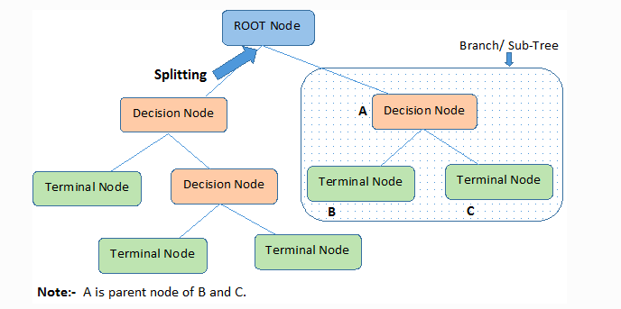
BEST MODEL – DECISION TREE
In a decision tree, for predicting the class of the given dataset, the algorithm starts from the root node of the tree.
This algorithm compares the values of root attribute with the record attribute and, based on the comparison, follows the branch and jumps to the next node.
For the next node, the algorithm again compares the attribute value with the other sub-nodes and move further.
It continues the process until it reaches the leaf node of the tree.

Slide 30




CONFUSION MATRIX
F1- Score
It is the weighted average of precision and recall
Precision And Recall
Precision is the fraction of relevant instances among the retrieved instances.
Recall is the fraction of relevant instances that have been retrieved over the total number of instances.
They are basically used as the measure of relevance.
Accuracy
Accuracy is a ratio of correctly predicted observation to the total observations.
True Positive: Number of correct predictions that the occurrence is positive.
True Negative: Number of correct predictions that the occurrence is negative.

Slide 31

DE
MODEL DEPLOYMENT
WEB BASED

Slide 32

MODEL DEPLOYMENT
Web Based Deployment:
Web based deployment is the process of deploying the code from source control to hosting platform.
Flask: It is a micro app framework for Data Science projects. It is a Python-based library that allows to create free machine learning applications with ease.
Cloud Deployment:
GitHub: It is a hosting site where developers and programmers can upload the code they create. This project on GitHub is an example of open-source software.
Heroku: It is a cloud platform that lets companies build, deliver, monitor and scale apps.
It integrates with GitHub to make easy deployment.

Slide 33
DEPLOYMENT LINK FOR MODEL
Cloud deployment link:
Cloud App link : https://employee02.herokuapp.com/

Slide 34
PROS AND CONS
PROS :
Rating make it easier to communicate performance.
Data can be used for compensation and succession planning.
Work achievement recognition increase morale of employees that leads to their good performance.
Employees that add value to the firm are considered first when better positions open up and employers decide to promote from within.
CONS :
Managers evaluating employees may show bias to certain employee.
Ratings are too subjective.
People focus on the number over the feedback .
Unreliable assessments can often occur due to flawed evaluation process.

Slide 35
CHALLENGES AND FUTURE SCOPE
Challenges:
Selection of right features and data Preparation to avoid flawed in a prediction model.
Lack of communication between manager and employee leads to bias rating.
To monitor employees performance and track their productivity is a difficult task.
Same parameters cannot be used to evaluate performance when employees working from remote location.
Future scope:
Increase confidence through recognizing strengths while identifying training needs to improve weaknesses.
Improve working relationships and communication between manager and employees.
Assist in decisions such as promotions or allocating rewards.
Allow time for self-reflection, self-appraisal and personal goal setting.
Provide employees with a better understanding of their role and responsibilities.
Allow time for self-reflection, self-appraisal and personal goal setting.

Slide 36

CONCLUSION
Decision tree classification algorithm works well in prediction of employee performance metrics with accuracy 98%.
The formulated model reduces the work of HR in monitoring, collecting and analyzing the employees' activities as there is a need to consider various attributes in Employees performance review.
Our model also helps the management in taking good decisions to compliment the dedicated and diligent employees by building appropriate Performance estimator.
It defines the proper work relationship, key skills to be developed and increases job satisfaction.

Slide 37


